Slide 1

C# Interfaces
Object Oriented
Programming…

Slide 2
Table of contents:
Going on a programming tour?
What is an Interface?
Why do we use them?
Limitations of Interfaces.
Difference b/w Interfaces and Abstract Classes.
Similarities b/w Interfaces and Abstract Classes.
Comparison b/w Interface and Inheritance.
Syntax for defining an Interface.
Example code activity.

Slide 3

What is an Interface?
“An interface is a logical structure that
Provides a specification rather than implementation”
It tells us “what to do” but not “how to do” it.
It enforces us to implement the certain specified methods or properties to the inheriting class…

Slide 4

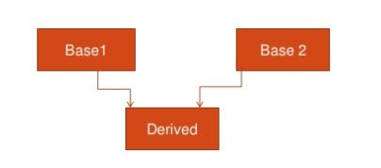
Why do we use interfaces?
C# does not allow multiple inheritance…
For example:
You can’t do this in C#
So the solution is to implement Base 2 class as an interface…

Slide 5
Why do we use interfaces?
Programmers use interfaces in order to restrict that certain specified functionality should must be implemented when inherited.
For example:
You’ve created some library and you want other developers to implement some certain methods / functionality during inheritance.
Because without this functionality the inheritance would be useless so you restrict the implementation as mandatory for other developers.

Slide 6
Limitations
C# Interfaces limitations:
Interfaces cannot have data members.
They can’t define Constructors, destructors.
No member can be declared static.

Slide 7
Differences b/w interfaces and abstract classes
Interfaces
Abstract Classes
Interfaces cannot contain any implementation.
They can’t declare non-public members.
Interfaces can not extend non-interfaces.
Can contain implementation.
They can declare non-public members.
Abstract classes can extend non- abstract classes.

Slide 8
Why these differences exist?
Creator’s choice:
All methods & constant values declared in an interface are implicitly public , static , final and abstract by default.

Slide 9
Similarities b/w interfaces and Abstract classes
Following are similarities:
Neither can be instantiated.
Neither can be sealed.
Neither can extend a sealed interface/class.

Slide 10
COMPARISON b/w Interfaces and Inheritance
Inheritance
Interface
Inheritance is a way how one class extends the functionality of another by inheriting it.
Interface is a collection of function which defines a contract that any 'implementing' class should override those functions.

Slide 11
Are interfaces a part of inheritance?
Creator’s choice:
Any class can implement a particular interface and importantly the interfaces are not a part of class hierarchy.
Interface:
Interface A { };
interface B : A { };
A a = new B(); // Error
// B can not act as A
Inheritance: class Son : Father { };
So, Father newFather = new Son();
// Class Son can act as Father in forms of “newFather”
Note: Class Hierarchy exists when 1 class extends another…

Slide 12
So why are they considered as similar to inheritance?
Logical explanation:
Use of Interface is similar to inheritance in a sense that it enables us to implement some functionality that the implementing class already doesn’t contain.

Slide 13
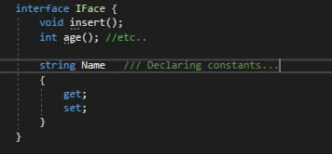
Syntax of defining Interfaces
Creator’s Choice:
interface <I(interface_name)> {
// methods & constant declarations…
}

Slide 14
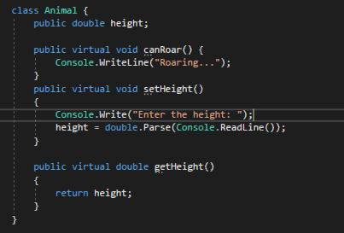
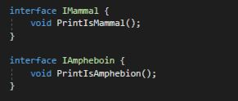
Code Example Activity

Slide 15
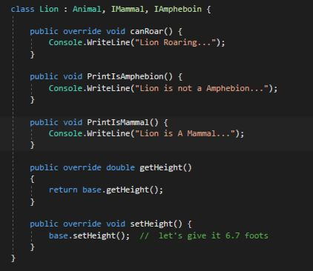
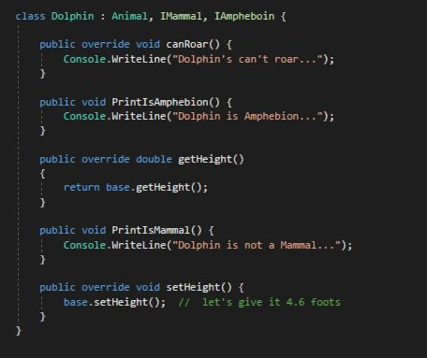
Code Example Activity

Slide 16
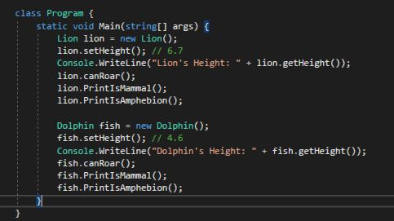
Code Example Activity

Slide 17
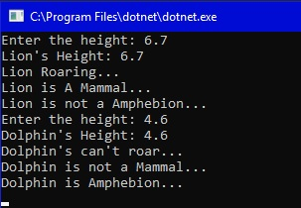
Code Example Activity(Result)

Slide 18
Any Questions?
Or anything you’d like to share?

Slide 19
A Friendly Programming advice…
Life is full of End Less miracles. So never stop at “What you already know” Keep on exploring.
For example: Let’s talk about number “0”.
(Anything) x 0 = Nothing
(Anything) / 0 = (Infinite possibilities, Unknown, Something)
Life Cycle: 0 <=> 1
Your brain: 0 => 1
The Main point is, be creative…

Slide 20

THANK YOU!
Have a nice day!

